Slide 1


PRESENTATION
MedCare
By:
Aayush Gyawali
Pratik Dhakal
Pratik Barakoti

Slide 2



MedCare
CONTENT
1
2
Overview of Project
Problem Statement
4
5
6
3
Objective
Algorithm
Expected Output
Future Plans

Slide 3



MedCare
Overview
MedCare is an innovative web-based platform designed to assist users in predicting potential diseases or health conditions based on provided symptoms

Slide 4




MedCare
Problem Statement
Time has been Overprice than before
Medical system is overloaded and time have become overpriced and valuation more than before.
Providing The Best Service For Patients
Individuals often face challenges in promptly identifying and addressing potential health concerns.

Slide 5



MedCare
Objectives
Identify potential health issues at an early stage by analyzing symptoms.
Provide recommendations for Drugs.
Appointment with the Doctor.

Slide 6
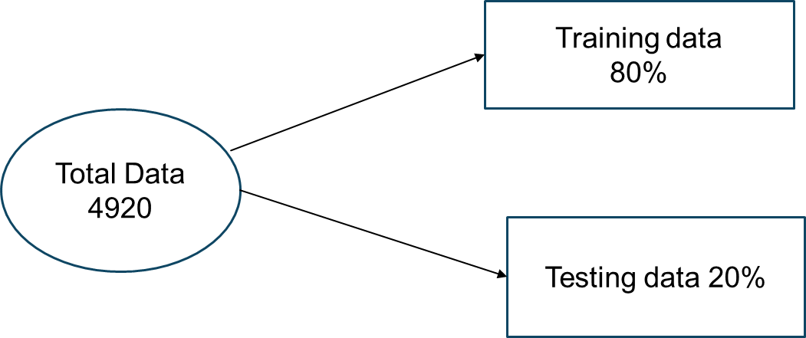
MedCare
Dataset
Control Room

Slide 7


ALGORITHM USED
Naive Bayes
Random Forest

Slide 8
MedCare
Naive Bayes
P(A|B) = P(B|A) * P(A) / P(B)
A: Represents the occurrence of a specific disease.
B: Represents the observed symptoms.
Control Room

Slide 9
MedCare
Random Forest
Random Forest is an ensemble learning technique that builds multiple decision trees and combines their predictions.
Control Room

Slide 10
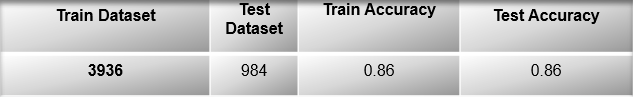
MedCare
Random Forest Model Performance
Control Room

Slide 11
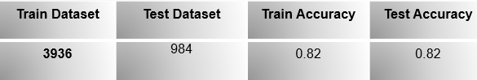
MedCare
Naive Bayes Model Performance
Control Room

Slide 12
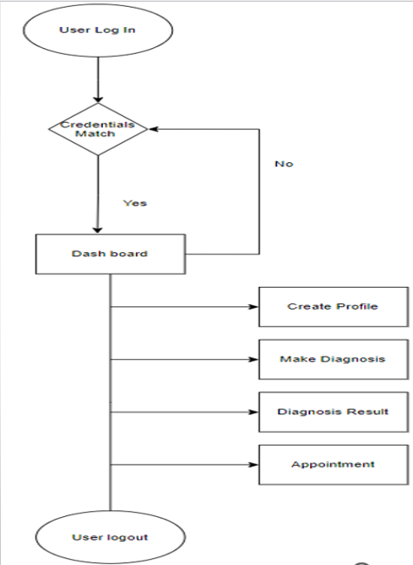
MedCare
User Workflow
Control Room

Slide 13
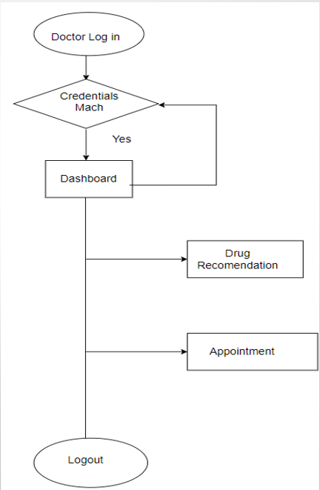
MedCare
Doctor Workflow
Control Room

Slide 14




MedCare
Our Services
Predict Disease
Appoint Doctor
Drug Recommendation
Predict diseases based on symptoms for proactive and efficient healthcare on our website.
Easily book doctor appointments
Get personalized drug recommendations

Slide 15
MedCare
Future Plans
Improved user interfaces
Improved data collection
Control Room
Add video appointments

Slide 16
MedCare
Conclusion
Our project has shown that technology has become so advanced that we can even digitally know about our health problems and even get appointment of doctor using Internet and a computer instead of going to hospitals physically
Control Room

Slide 17

MedCare
Thank
You.
For Your Attention

